Slide 1

Note: The data and information in this document is reflective of a hypothetical situation and client. This document is to be used for KPMG Virtual Internship purposes only.
Sprocket Central Pty Ltd
Data analytics approach
[Division Name] - [Engagement Manager], [Senior Consultant], [Junior Consultant]

Slide 2
Note: The data and information in this document is reflective of a hypothetical situation and client. This document is to be used for KPMG Virtual Internship purposes only.
Agenda
Introduction
Data Exploration
Model Development
Interpretation

Slide 3
Note: The data and information in this document is reflective of a hypothetical situation and client. This document is to be used for KPMG Virtual Internship purposes only.
Introduction
Place headline insight or information here. This should be the most important point for this slide.
Gender-wise Distribution
Age distribution
Job industry category.
Wealth segments
Statewise Analysis
Number of cars owned in each state

Slide 4
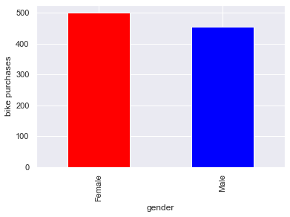
Note: The data and information in this document is reflective of a hypothetical situation and client. This document is to be used for KPMG Virtual Internship purposes only.
Data Exploration-Gender
Genderwise Distribution of Bike Purchases
As we can see, more purchases were made by women than by men. Hence women can be a high value target audience.
Place any supporting images, graphs, data or extra text here.

Slide 5
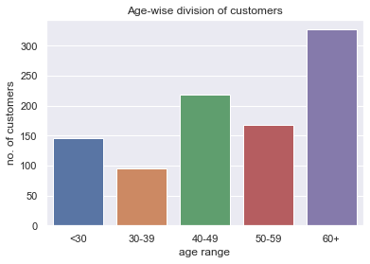
-
Note: The data and information in this document is reflective of a hypothetical situation and client. This document is to be used for KPMG Virtual Internship purposes only.
Data Exploration-Age
Agewise Distribution of Bike Purchases
This plot shows the distribution of custoers by age. As we can see here, people aged 60 and more form a significant portion of the customers.
Place any supporting images, graphs, data or extra text here.

Slide 6
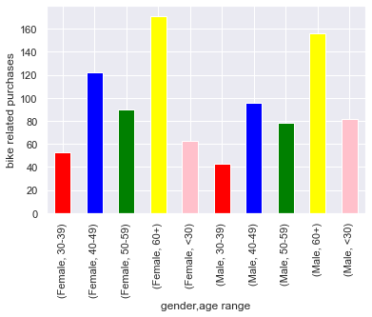
Note: The data and information in this document is reflective of a hypothetical situation and client. This document is to be used for KPMG Virtual Internship purposes only.
Data Exploration-Gender and Age
Age and Genderwise Distribution of Bike Purchases
Combining the two categories, we can have a deeper look at how customers are distributed. Here we can see that women aged 60 and above have made the most bike related purchases, followed by men aged 60 and above.
Place any supporting images, graphs, data or extra text here.

Slide 7
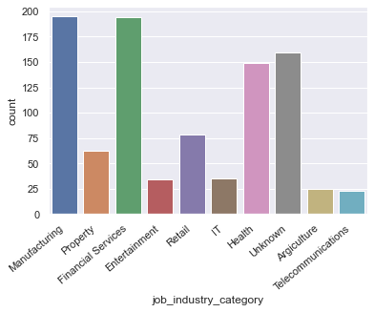
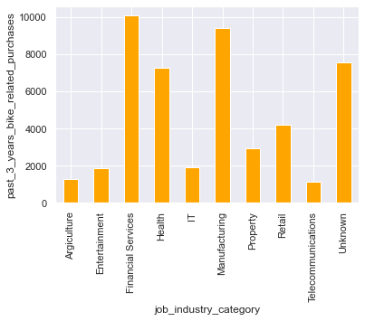
Note: The data and information in this document is reflective of a hypothetical situation and client. This document is to be used for KPMG Virtual Internship purposes only.
Data Exploration- sales and number of purchases by industry
Trend of sales and number of purchases by job industry
As per count of purchases, Manufacturing, Financial Services and health are the top 3 industries while as per total amount of revenue contributed, Financial Services comes at the top followed by Manufacturing and Health. Moreover, a significant proportion of both plots have an unknown job industry.

Slide 8
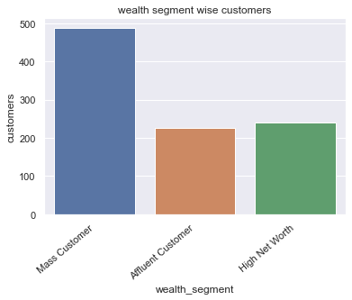
Note: The data and information in this document is reflective of a hypothetical situation and client. This document is to be used for KPMG Virtual Internship purposes only.
Data Exploration-
Analysis by wealth segment
We can see here that mass customers constitute the biggest share of the customer base.
Place any supporting images, graphs, data or extra text here.

Slide 9
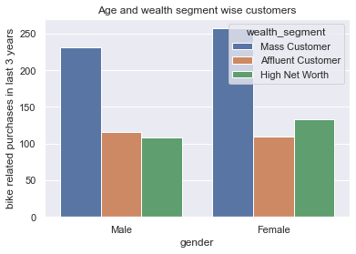
Note: The data and information in this document is reflective of a hypothetical situation and client. This document is to be used for KPMG Virtual Internship purposes only.
Data Exploration-
Analysis by wealth segment and gender
This plot confirms the insights made by the genderwise and wealth segmentwise plots i.e. women and mass customers form a significant portion of the customer base.
Place any supporting images, graphs, data or extra text here.

Slide 10
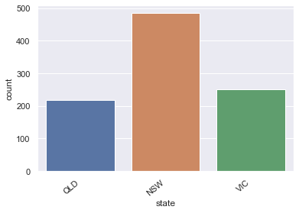
Note: The data and information in this document is reflective of a hypothetical situation and client. This document is to be used for KPMG Virtual Internship purposes only.
Data Exploration-state
Analysis by State
We can see here that customers from NSW constitute the biggest share of the customer base
Place any supporting images, graphs, data or extra text here.

Slide 11
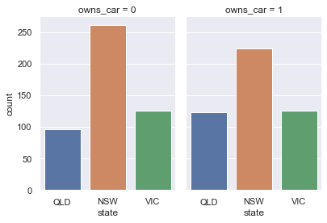
Note: The data and information in this document is reflective of a hypothetical situation and client. This document is to be used for KPMG Virtual Internship purposes only.
Data Exploration-
Analysis by state and by car ownership
We can see here that people from NSW not owning cars have made the most bike related purchases.
In general, car ownership doesn’t seem to affect bike related purchases.
Place any supporting images, graphs, data or extra text here.

Slide 12
Note: The data and information in this document is reflective of a hypothetical situation and client. This document is to be used for KPMG Virtual Internship purposes only.
Model Development
High Value Customers to be targeted-
Mass Customer
Aged 60+
Female
Working in Financial Service, Manufacturing and Health.
Currently living in New South Wales and Victoria.

Slide 13
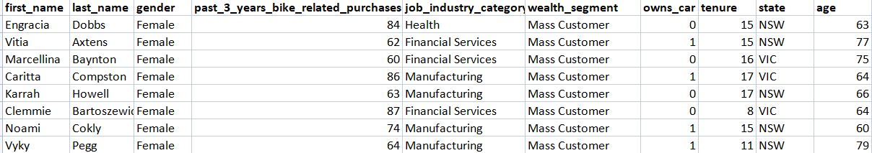
Note: The data and information in this document is reflective of a hypothetical situation and client. This document is to be used for KPMG Virtual Internship purposes only.
Interpretation
High Value Customer Summary

Slide 14
Note: The data and information in this document is reflective of a hypothetical situation and client. This document is to be used for KPMG Virtual Internship purposes only.
Appendix

Slide 15
Note: The data and information in this document is reflective of a hypothetical situation and client. This document is to be used for KPMG Virtual Internship purposes only.
Appendix
This is an optional slide where you may place any supporting items.

